Slide 1
Name:
Will Dargan
Specification & learning objectives
By the end of this topic you will have studied:
Types of network: LAN, WAN
Factors that affect the performance of networks
The different roles of computers in a client-server and peer-to-peer network
The hardware needed to connect stand-alone computers to a LAN: Wireless access points, Routers, Switches, NIC, Transmission media
The Internet as a worldwide collection of computer networks: DNS, Hosting, The Cloud, Web servers and clients
Star and Mesh network topologies
Modes of connection: Wired (Ethernet), Wireless (Wi-Fi, Bluetooth)
Encryption
IP addressing and MAC addressing
Standards
Common protocols including: TCP/IP, HTTP, HTTPS, FTP, POP, IMAP, SMTP
The concept of layers
Resources
We recommend the OCR endorsed text book from PG Online for use during your GCSE studies.
Craig'n'Dave videos for SLR 1.3
Notes:
Activity…

Slide 2


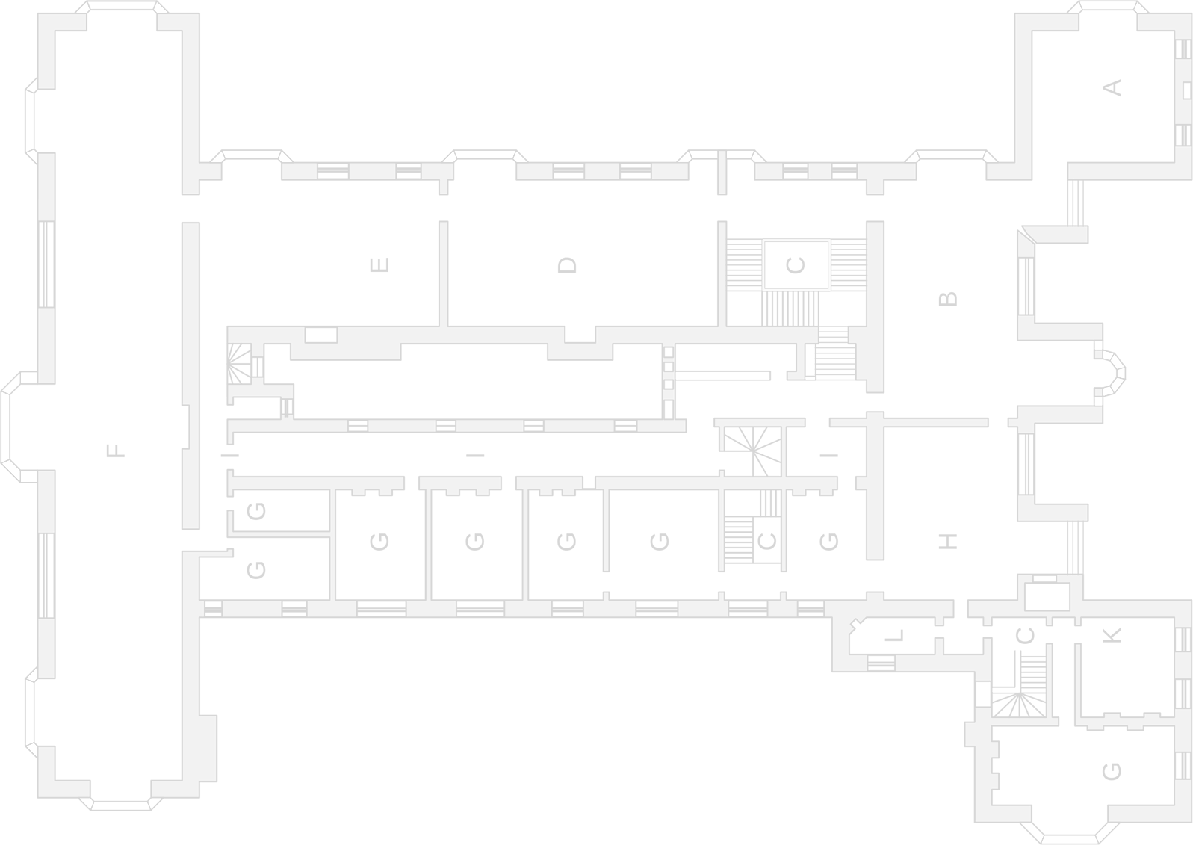

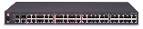
Types of networks
Representation of a local area network (LAN):
Representation of a wide area network (WAN):
Description of a local area network:
Description of a wide area network:
Small geographical area
Owned by the user
UTP or Wifi
Large geographical area
Not owned by the user
Fibre
Computers that are not connected to a network are called stand-alone computers.
Notes:
Using copies of the images on the slide and lines representing cables, create an illustration of what a LAN and a WAN looks like conceptually.
Write 3 bullet points to describe a LAN.
Write 3 contrasting bullet points to describe a WAN.

Slide 3
The advantages and disadvantages of networks
The advantages of networks include:
Sharing files
Sharing peripherals
Accessing files from any computer
The disadvantages of networks include:
Increased security risk
Malware and viruses travel easily
Computers may slow down with lots of traffic
Notes:
List the advantages of networks.
List the disadvantages of networks.

Slide 4


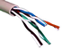



Factors that affect the performance of networks
Number of users
More users mean more bandwidth used so error rate increases so slower overall.
Error rate
Higher error rate means data needs to be sent more times so slower overall.
Transmission media
Wired connections have higher bandwidth than wireless.
Fibre optics have a higher bandwidth than copper.
Bandwidth
A lower bandwidth means less data that can be transmitted at once so the connection is slower overall.
Latency
Higher latency means higher delay so slower connection.
Notes:
Explain how each of the five factors listed impacts on the speed of a network.

Slide 5

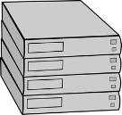

The different roles of computers in a client-server and a peer-to-peer network
Both local area networks and wide area networks can operate as either a client-server or a peer-to-peer approach when sharing data.
Client Server
Peer to Peer
Server
Peer
Logical connection
Client
Server handles security, updates, peripherals and requests.
Client sends requests to the server and receives data back.
Peers are responsible for their own security, updates and peripherals.
Peers can communicate with each other.
Notes:
Correctly label each illustration either ‘client-server’ or ‘peer-to-peer’.
Add additional labels to each illustration to indicate which devices are servers, clients or peers.
In the appropriate box underneath each illustration, explain what a server does, what a client does, and what peers do.

Slide 6
Advantages and disadvantages of client-server and peer-to-peer approaches to data sharing
Green indicates advantages, red indicates disadvantages.
Client-server model
Peer-to-peer model
Advantages:
Advantages:
Easier to take backups of all shared data.
Very easy to maintain. Specialist staff are not required.
Easier to manage security of files.
No dependency on a single machine.
Easier to install software updates.
Cheaper to set up. No expensive hardware required.
Disadvantages:
Disadvantages:
Requires IT specialists to maintain.
Can be difficult to maintain a well ordered file store.
Can be expensive to set up and maintain.
Users will need to manage their own backups.
A single point of failure. Users will lose access if the server fails.
The network is less secure.
Notes:
Group the statements on this slide into the correct box.
Colour the background of each statement to green for advantage and red for disadvantage.

Slide 7
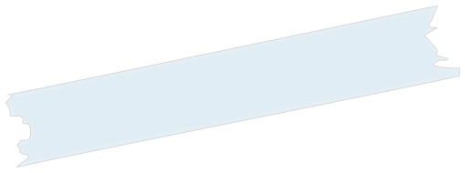





Hardware for a local area network
Wireless Access Point
Allows wireless devices to connect to LAN
Less bandwidth than wired
Switch
Sends data between devices on a LAN
Segments the network and directs data traffic
NIC
Uses protocols to determine how a connection works
Allow devices to connect to wired or wireless
Router
Connects LANs to a WAN
Uses IP to route traffic
Sends data between networks.
Media
UTP – Wired has large bandwidth, reliable and secure
Fibre – Uses light, covers long distances, greater bandwidth
Notes:
Using the graphical assets on the slide to add interest, create a scrapbook page illustrating and explaining the purpose of:
Wireless access points
Routers
Switches
Network interface cards
Transmission media: UTP (CAT5e/6) and fibre optic

Slide 8
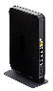

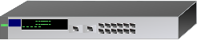
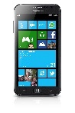
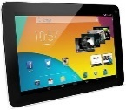

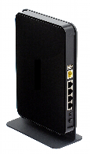

The Internet
The Internet is:
The most widely known WAN.
Google server
Internet service provider Domain name server
Request www.google.com
www.google.com → 8.8.8.8
Domain name server
Hosting
The cloud
A DNS is a giant database containing the IP addresses which relate to domain names.
A host is a company which owns many servers with extremely fast connections to the Internet. You can rent these servers to fun web pages.
A system of many servers with extremely large storage capacity which can be accessed from anywhere.
Notes:
Complete the definition of The Internet.
Using the illustration as stimulus material, explain what is meant by a domain name server, hosting and the cloud.
Include advantages of DNS, hosting and the cloud to the users.

Slide 9
Web servers, clients and the cloud
The cloud
The relationship between servers and clients on the Internet:
Advantages:
Client sends and receives data from a server. Server processes data and runs programs.
Excellent backup and recovery options.
No hardware required since everything is hosted in the cloud.
Accessibility. Access your data anywhere, anytime.
Client sends request to web server, web server returns website data.
Room for growth. Easy to scale up and expand.
Web server
Client
Disadvantages:
Client requests a file from file server file is sent to client.
Ongoing monthly / yearly cost for hosting data and information.
Lack of control. Handing over of data and information.
File server
Client
Relies completely on a stable internet connection.
Bandwidth problems. All depends on speed of connection.
Notes:
Complete the box to explain the relationship between servers and clients.
Complete the box to describe the client/server relationship between a web server and a mobile phone.
Complete the box to describe the relationship between a file server and a desktop PC.
Group the statements about “The cloud” into the correct box.
Colour the background of each statement to green for advantage and red for disadvantage.

Slide 10

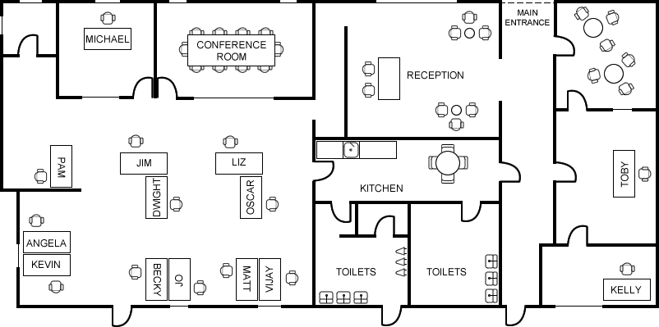

Star network topology
Notes:
Assume every member of staff has a computer on their desk. Assume reception has two computers. Assume the conference room has a computer. Using the computer, switch icons, and straight lines representing twisted pair cable, show how reception, Kelly and Toby’s computers can be connected together to a switch outside Toby’s office in a star network topology.
Colour the twisted pair lines purple so they stand out on the illustration.
Show how Michael, Liz, and her office colleagues can be connected to a second switch outside the conference room in a star network topology.
Show how the two switches are connected together.
Show how the server in the room next to Michael can be connected to the network.

Slide 11
Star network topology
The weakness of the star network topology as illustrated in the diagram on the previous slide is:
A switch is a single point of failure.
Full mesh network topology
The advantage of connecting computers together in a full mesh topology is:
There is no single point of failure.
The disadvantages of connecting computers together in a full mesh topology are that:
It is expensive due to lots of hardware
Notes:
Explain the biggest weakness of a star network.
Illustrate how a full mesh network overcomes this problem using computer, switch, and lines representing twisted pair connections. A computer only has one network card with one connection. Switches have multiple connections.
Explain one advantage and two disadvantages of a full mesh network.

Slide 12
Partial mesh network topology
The internet is an example of a partial mesh network:
Notes:
Illustrate how the internet is an example of a partial mesh network using the icons provided, and lines representing connections between routers.
Show the local area network connections in purple, and the wide area connections in green.

Slide 13
Mesh wireless network topology
Notes:
Using the ruler, draw a circle with a radius of 8. (Click view… ruler…)
Colour the circle so it is a transparent blue, and the office can be seen through the circle. (Drawing tools… format… shape fill… more fill colours…)
Put a wireless access point in the middle of the circle, and group the objects. The circle represents the range of the access point. The colour represents the frequency.
Show how the office could be connected in a wireless mesh topology: - each wireless access point must be in range of at least one other access point; - every computer and server must be connected; - a wireless access point must be screwed to a wall;

Slide 14
Mesh wireless network topology
The advantages of a wireless mesh network topology are:
Little cabling needed
Devices can be mobile
No single point of failure
Fast connections
The disadvantages of a wireless network topology are:
Expensive hardware
Specialist needed
Notes:
Complete the boxes to explain 4 advantages and 4 disadvantages of mesh wireless networks compared to wired networks.

Slide 15
Modes of connection: Wired - Ethernet
Ethernet is a used for communication on a .
Ethernet has largely replaced competing wired LAN technologies.
The original Ethernet used , while the newer Ethernet uses
with a to connect components together. Over the course of its history, Ethernet data transfer rates have been increased from the original 2.94 megabits per second to 100 gigabits per second.
Systems communicating over Ethernet divide a stream of data into shorter pieces called a .
Each contains a , and a used for error checking so that damaged transmissions can be detected.
Ethernet provides networking protocols up to the of the open standards interconnection model.
Standard for networking technologies
Wired local area network
Coaxial cable as a shared medium
Twisted pair and fibre optic links
switch
frame
Source and destination address
Cyclic redundancy check
Data link layer
Notes:
Find out about the Ethernet standard, and complete the blanks using the words: source and destination address switch data link layer standard for networking technologies coaxial cable as a shared medium frame wired local area network twisted pair and fibre optic links cyclic redundancy check

Slide 16


Modes of connection: Wireless – Wi Fi and Bluetooth
Wi-Fi is ideal around the home as it has a long range and needs no cables.
Bluetooth ideal for personal devices as it has short range..
Wi-Fi
Range | 100m
Bandwidth | High
Power consumption | High
Bluetooth
Range | 10m
Bandwidth | Low
Power consumption | Low
Notes:
Complete the two boxes to provide an explanation of Wi-Fi and Bluetooth.
Complete the two tables, the options for each row are as follows:
- Range: 10 meters or 100 meters
- Bandwidth: Low or High
- Power consumption: Low or High

Slide 17
Benefits and drawbacks of wired versus wireless connection
Green indicates advantages, red indicates disadvantages.
Wired networks
Wireless networks
Advantages:
Advantages:
More secure / easier to secure this type of network.
Tends to be easier to share files as physical connections not required.
Connections and connection speeds tend to be more reliable.
Transfer speeds to be slower on this type of network.
Transfer speeds tend to be faster on this type of network.
Users can access network from anywhere within range.
Disadvantages:
Disadvantages:
Users location is limited by need for a cable connection.
Less secure / more steps need to be taken to make sure its secure.
Generally less convenient to share files as physical connection required.
Connection tends to be less reliable and can easily be blocked by walls and other physical infrastructure.
Lots of cables, connections, ports and more physical hardware needed.
Far less complicated physically, less disruptive to set up.
Notes:
Group the statements on this slide into the correct box.
Colour the background of each statement to green for advantage and red for disadvantage.

Slide 18
Recommending a connection for a given scenario
A local school has a set of very old buildings which where built long before the modern Internet took shape. They wish to install a teachers PC in each classroom and students should be able to connect to the network from any location. Reliable connections are required but fast data transfer speeds are not essential. State whether you would recommend a wired, wireless or hybrid solution and provide reasons to back this up.
A hybrid system would be best here. Wired connections to each room would avoid the issue of radio waves being absorbed by obstructions. The teachers' PCs should be wired to the wall. Each room should a wireless access point so that students can access the network from anywhere.
A brand new state of the art building is being designed for a large scale corporate business. It is essential that the business has a very reliable, fast and secure data transfer on its network. State whether you would recommend a wired, wireless or hybrid solution and provide reasons to back this up.
A wireless mesh topology would work well here. Wireless so the network can be accessed from anywhere and also a new building would allow signals to travel swiftly and strongly through walls. A mesh topology would make the connection fast due to the boosting effect of each device. Also, the network would be reliable because the mesh does not have a single point of failure and has lots of room for redundancies.
Notes:
Complete the boxes.

Slide 19
Wi-Fi encryption
A wireless device broadcasts an SSID to other devices to enable connections to be made between devices on the same network.
An older encryption method called WEP has been replaced by a more secure method called WPA.
A master key is created and used to encrypt and decrypt data between two wireless devices.
A simple illustration of how master keys can work using a substitution cipher:
character | B | A | S | I | C | S | U | B | S | T | I | T | U | T | I | O | N | C | I | P | H | E | R
key | 1 | 3 | 4 | 8 | 7 | 3 | 4 | 3 | 7 | 6 | 1 | 7 | 6 | 8 | 8 | 9 | 6 | 9 | 1 | 3 | 4 | 8 | 7
cipher text | C | D | W | Q | J | V | Y | E | Z | Z | J | A | A | B | Q | A | S | L | J | R | L | M | Y
character | H | E | L | L | O | W | O | R | L | D | I | C | H | H | E | I | S | S | E | W | I | L | L
key | 1 | 4 | 5 | 7 | 4 | 8 | 3 | 2 | 6 | 7 | 8 | 0 | 3 | 5 | 4 | 7 | 1 | 2 | 3 | 4 | 9 | 7 | 3
cipher text | I | I | Q | S | S | E | R | T | R | K | Q | C | K | M | I | P | T | U | H | A | R | S | O
Notes:
Create your own key, and show how a message can be encrypted using a substitution cipher.
Create a message for someone else in the class to decode. Note how it would be very difficult for them to work out what the message is without the key. Sharing the key makes it vulnerable to interception though, so master keys should be known, but not communicated.

Slide 20

Wi-Fi encryption
Wireless device
Before communication between devices using the master key takes place, each wireless device is authenticated as having the correct master key using a four-way handshake. This ensures that data can only be sent and received by devices who have a correct master key.
Wireless device
⓿
⓿
Client Station
Access Point
A random number is sent with the network interface card address.​
❶
Transient key is calculated.
❷
Master key is generated from the wireless password.
Transient key is calculated from the master key, the random number sent, my random number generated, and the network card addresses.
A group temporal key is calculated and sent with a message integrity code.
❸
❹
An acknowledgement is sent confirming communication can begin.
Notes:
Research the IEEE 802.11i-2004 WPA2 protocol. Show how wireless encryption works by putting the correct text in the boxes: Master key is generated from the wireless password. An acknowledgement is sent confirming communication can begin. A random number is sent with a message integrity code. Transient key is calculated from the master key, the random number sent, my random number generated, and the network card addresses. Transient key is calculated. A random number is sent with the network interface card address. A group temporal key is calculated and sent with a message integrity code.

Slide 21
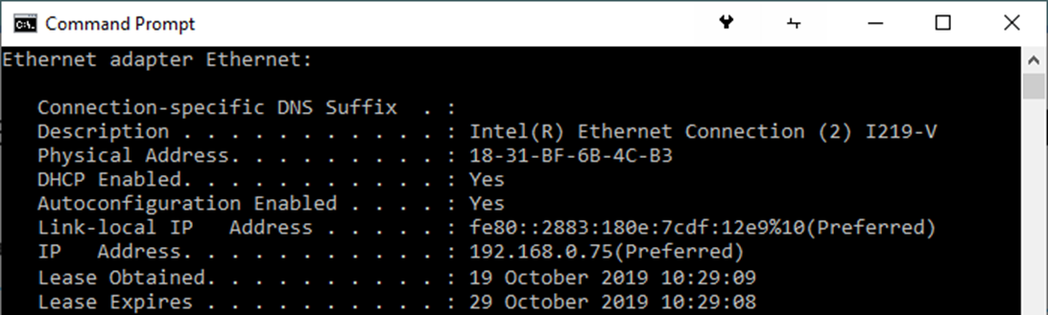
The uses of IP addressing (IPv4 & IPv6) and MAC addressing
There are two types of addressing used for local and wide area networks:
MAC address
Media Access Controller Address
Every piece of network hardware has a unique MAC address.
IP address
Internet Protocol Address
An IP address is set in software not hardware.
The reason we have IPv6 is:
There are not enough IPv4 addresses for the number of devices we have.
The results of the “ipconfig /all” command on a Windows machine showing an IPv4, IPv6 and MAC address:
Notes:
In the top two rows provide details of the two types of addressing used for local and wide area networks:
In the second box provide the full name of the acronym stated in the first box.
In the third box provide a description of the address.
State the reason for IPv6.
On the picture highlight an example of: 1) An IPv4 address, 2) An IPv6 address, 3) A MAC address.
For the IPv4 address, highlight which part of the address identifies the network and which part identifies the client computer (called a node).

Slide 22
Standards and protocols
The need for standards:
So more than one device will all recognise the same binary sequence as the same letter or number or command etc.
A network protocol is a set of rules governing the communication between devices on a network. Some protocols include:
HTTP
Hypertext Transfer Protocol
A client-server method of requesting and delivering HTML files.
POP
Post Office Protocol
Sends mail to a mail server.
HTTPS
Hypertext Transfer Protocol Secure
Encryption and authentication for client-server data.
TCP/IP
Transmission Control Protocol / Internet Protocol
Provides an error free transmission between two routers (TCP) and routing of packets on a wide area network (IP).
SMTP
Simple Mail Transfer Protocol
Used by email clients to retrieve email from a mail server, and to manage remote mail boxes. Better than POP.
FTP
File Transfer Protocol
Sending files between computers. Used for uploading web pages and associated files to a web server for hosting.
IMAP
Internet Message Access Protocol
Used by email clients to retrieve email from a mail server.
Notes:
Complete the top box.
Sort the cards into 3 columns: acronym, protocol name and description.

Slide 23
The concept of layers
The concept of layering is to divide the complex task of networking into smaller, simpler tasks that work with each other.
The hardware and/or software for each layer has a defined responsibility.
Each layer provides a service to the layer above it.
The advantages of layering include:
Layer 4
Browser
using
HTTPS
Reduce complexity
Devices manufactured for specific layers
Products from different vendors interchangeable
TCP Error handling
Layer 3
Layer 2
IP
routing
Layer 1
MAC
Frames
(Sent over fibre optic)
Notes:
State 3 advantages of layering a complex task like networking.
Complete the jigsaw puzzle to show how all the component parts of networking that you have learned operate together in different layers.
Show a second puzzle for the scenario of sending a HTML presented email with no encryption over a Wi-Fi link to a mail server.

Slide 24
Assessment |  |  |  | Target: |  | Overall grade:
Minimum expectations by the end of this unit
□ | You should have learnt terms 61-96 from your GCSE Level Key Terminology during this unit.
□ | You have completed all the pages of the workbook
□ | Score 80% in the end of unit test.
Feedback
Breadth |  | Depth |  |  | Understanding
□ All aspects complete |  | □ Excellent level of depth |  |  | □ All work is accurate
□ Most aspects complete |  | □ Good level of depth |  |  | □ Most work is accurate
□ Some aspects complete |  | □ Basic level of depth shown |  |  | □ Some work is accurate
□ Little work complete |  | □ Little depth and detail provided |  |  | □ Little work is accurate
Comment & action |  |  | Student response

Slide 25
Reflection & Revision checklist
Confidence | Clarification
☹ 😐 ☺ | I can explain what a LAN is
☹ 😐 ☺ | I can explain what a WAN is
☹ 😐 ☺ | I can explain factors that affect the performance of networks
☹ 😐 ☺ | I can explain the difference roles of computers in a client-server and peer-to-peer network
☹ 😐 ☺ | I can explain the hardware needed to connect to stand-alone computers in a LAN
☹ 😐 ☺ | I can explain what a Wireless Access Point is
☹ 😐 ☺ | I can explain what a router and switch is
☹ 😐 ☺ | I can explain what a Network Interface Card is
☹ 😐 ☺ | I can explain what transmission media is
☹ 😐 ☺ | I can explain what the Internet is
☹ 😐 ☺ | I can explain what DNS is
☹ 😐 ☺ | I can explain what hosting is
☹ 😐 ☺ | I can explain what the cloud is
☹ 😐 ☺ | I can explain what is meant by web servers and clients
☹ 😐 ☺ | I can explain what a start network is
☹ 😐 ☺ | I can explain what a mesh network is
My revision focus will need to be:

Slide 26
Reflection & Revision checklist
Confidence | Clarification
☹ 😐 ☺ | I can explain what is meant by a wired and wireless network
☹ 😐 ☺ | I can explain various modes of connection, such as: Ethernet, Wi-Fi, Bluetooth
☹ 😐 ☺ | I can compare the benefits and drawbacks of wired versus wireless connection
☹ 😐 ☺ | I can recommend one or more connections for a given scenario
☹ 😐 ☺ | I can explain what network encryption is
☹ 😐 ☺ | I can explain what IP addressing is along with the IP address formats IPv4 and IPv6
☹ 😐 ☺ | I can explain what a MAC address is
☹ 😐 ☺ | I can explain the principle of a standard to provide rules for areas of computing
☹ 😐 ☺ | I can explain what the TCP/IP protocol col
☹ 😐 ☺ | I can explain what the HTTP & HTTPS protocol is
☹ 😐 ☺ | I can explain what the FTP protocol is
☹ 😐 ☺ | I can explain what the POP protocol is
☹ 😐 ☺ | I can explain what the SMTP & IMAP protocol is
☹ 😐 ☺ | I can explain the concept of layers
My revision focus will need to be:

